Slide 1
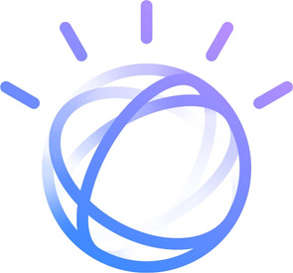


AI Applications in Different Spheres
A Presentation on AI in Transportation, Healthcare, Business, Creativity, and Security

Slide 2
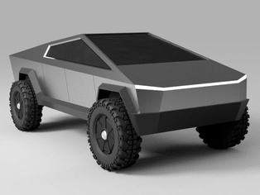
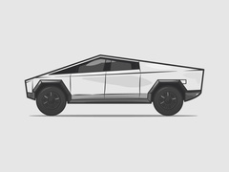
Tesla Autopilot
AI-powered self-driving technology that assists with steering, braking, and lane changes.
How Tesla Autopilot Works
• - Uses cameras, radar, and sensors to detect surroundings.
- Al-powered neural networks analyze real- • time data for safe driving.
• - Improves with machine learning based on data from Tesla drivers.

Slide 3


IBM Watson Health
AI system for medical diagnosis, treatment recommendations, and research
How IBM Watson Health Works
- Uses natural language processing to read medical texts.
- Analyzes patient records and suggests possible diagnoses.
- Helps doctors make data-driven treatment decisions.

Slide 4

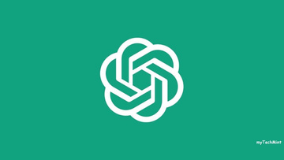
ChatGPT
AI chatbot for writing, coding, customer service, and general communication.
How ChatGPT Works
- Built on GPT-4, a large language model.
- Uses deep learning to generate human-like text.
- Assists with writing, coding, and customer support.

Slide 5
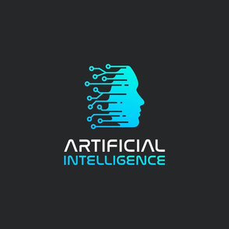
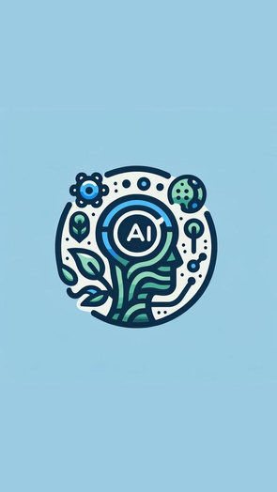
DALL·E
AI that generates images from text descriptions for art and design.
How DALL·E Works
Uses deep learning to generate images from text prompts.
- Creates photorealistic, artistic, or surreal visuals.
- Useful for graphic design, marketing, and digital art.

Slide 6


Darktrace
AI cybersecurity system that detects and prevents cyber threats.
How Darktrace Works
- AI-powered cybersecurity that detects threats in real time.
- Learns normal network behavior and identifies anomalies.
- Protects businesses from data breaches and hacking.

